Slide 1

ONLINE SHOPPING SYSTEM
ROHAN AHIRE 20104133
CHIRAG KADAM 20104105
PRATHAM BHAGWAT 20104095
ATHARVA ANKALWAR 20104098
Project Guide
PROF. APEKSHA MOHITE

Slide 2
Contents
Introduction
Objectives
Scope
Features / Functionality
Project Outcomes
Technology Stack
Block Diagram if applicable

Slide 3
1. Introduction
Shopping has long been considered a recreational activity by many. Shopping online is no exception.
The goal of this application is to develop a web based interface for online retailers. The system would be easy to use and hence make the shopping experience pleasant for the users

Slide 4
Problem Identified
In this busy life schedule , people get barely time for shopping.
Offline stores have space constraints and have limited range of products which leads to go from one shop to another can be exhausting and time consuming.
Solution Proposed
Through Online Shopping people can get a wide range of products.
Convenience of shopping from home.

Slide 5
2. Objectives
To provide a unique customer experience.
To enhance efficiency of your services.
Establishing brand awareness and corporate identity.

Slide 6
3. Scope
Through Online Shopping we can save our money because prices are less than market prices and we receive our bought things at our home.
Online storefronts are open 24/7 to serve customers – no more worrying about missing out because of holidays, strikes, or even lockdowns.
Online stores clearly mention return and exchange policies on the site, making it easy for shoppers to decide.
Online shopping offers great safety in shopping from home, especially in times like the present – when the global pandemic is threatening the health of all those who mingle in public.

Slide 7
4. Feature /Functionality
Userfriendly.
Advance search function.
Shows the information and description of the Products.
Customer reviews system.
Cash on delivery and Online payments.
We can compare various Brands.
Through Online Shopping we can save our time and money as compare to the market place.

Slide 8
5. Outcome of Project
To develop an easy to use web based interface where users can search for products, view a complete description of the products and order the products
A search engine that provides an easy and convenient way to search for products specific to their needs. The search engine would list a set of products based on the search term and the user can further filter the list based on various parameters.
A user can view the complete specification of the product along with various images and also view the customer reviews of the product. They can also write their own reviews.

Slide 9
6. Technology Stack
Frontend -
Eclipse IDE (Java) :Version 4.21.0 (Sep 2021 Release)
Javafx SDK : Oracle SE Development Kit 17.0.0.1
Database -
Administration tool : PhpMyAdmin (MySQL)

Slide 10
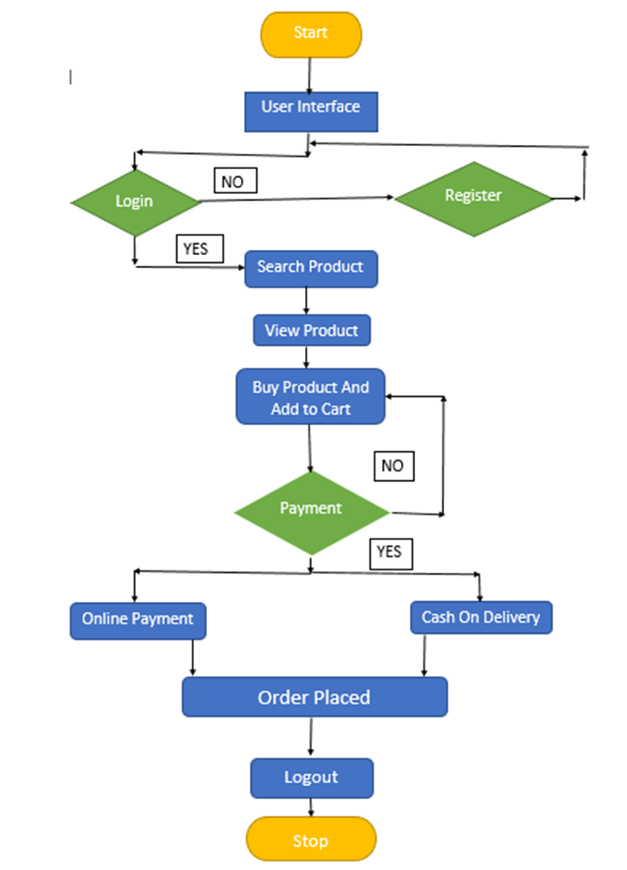
7. Block Diagram

Slide 11
Thank You...!!

